Slide 1


Stubborn Mining: Generalizing Selfish Mining and Combining with an Eclipse Attack
Kartik Nayak
With Srijan Kumar, Andrew Miller and Elaine Shi

Slide 2

Bitcoin Mining
Blockchain
Fairness: If Alice has 1/4th computation power, she gets 1/4th of the total reward
Charlie
Bob
Dave
Alice
Emily

Slide 3
If Alice deviates from the protocol, can she gain more?
Selfish Mining [ES’14]
Yes!
Computation power > 0.33
Charlie
Bob
Dave
Alice
Emily

Slide 4
Prior work:
Selfish Mining
One way of deviating so that one miner earns more revenue at the expense of others
1
Our Contribution:
Stubborn Mining
We show other attacks in the same model that perform better than selfish mining
Earn ~$137,000 / day more than by Selfish Mining attack
All miners earn ~$1.5 M / day

Slide 5
Eclipse Attacks
[HKZG’15]
Alice can double-spend
Our Contribution:
2
Compose Stubborn Mining and Eclipse Attacks
World 1
World 2
Bob
Charlie
Dave
Alice
Emily

Slide 6
Key Contributions
1
Stubborn Mining
2
Compose Stubborn Mining and Eclipse Attacks
Both of these attacks are better than were previously known for the attacker
Sometimes, the best strategies benefit the “victim”

Slide 7
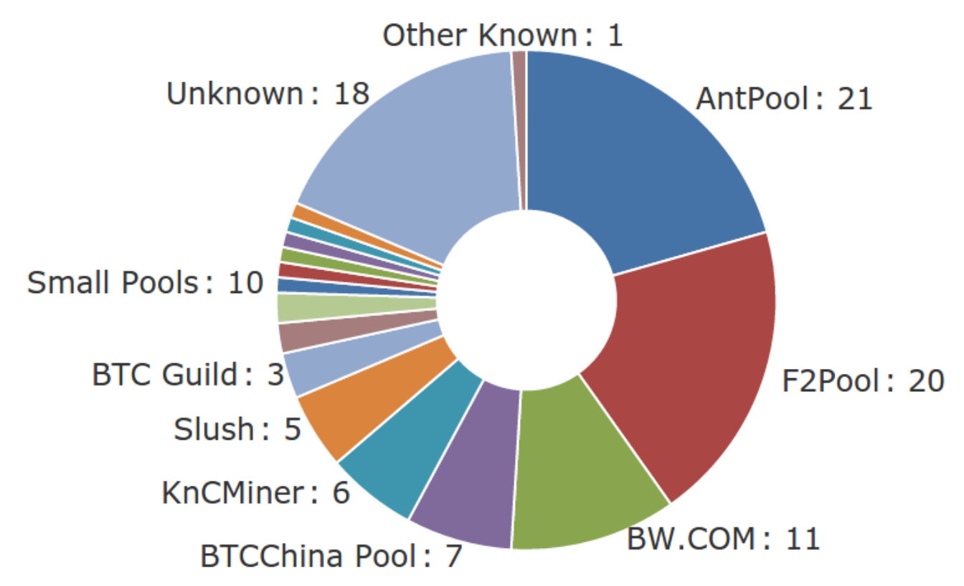
Selfish Mining
(in more detail)
γ: Alice’s ability to win race conditions
Alice
(α)
Public
(β)
(α, γ): network model parameters
40%: Ghash.IO largest pool in 2014
Bob
Charlie
α
41%: two largest mining pools
21%: largest mining pool
Dave
Alice
γ
0-0.92: depending on attacker’s influence
Emily
https://blockchain.info/pools - May 16, 2015

Slide 8
Selfish Mining
(in more detail)
γ: Alice’s ability to win race conditions
Alice
(α)
Public
(β)
(α, γ): network model parameters
Alice’s private chain
Public’s view
α
α
α
0
1
2
3
β
β

Slide 9
Selfish Mining
(in more detail)
Alice
(α)
Public
(β)
Public’s view
α
α
α
0
1
2
3
β
β

Slide 10
Selfish Mining
(in more detail)
Alice
(α)
Public
(β)
γ: Fraction of public mining on Alice’s block
Alice’s private chain
Public’s view
0’
β
(1-γ)β
γβ
α
α
α
α
0
1
2
3
β
β
A strategy where Alice reveals blocks under certain conditions

Slide 11
Our Contribution: Stubborn Mining
Intuition: A selfish miner gives up too easily
Three stubborn mining strategies:
Lead Stubborn Mining
Equal-Fork Stubborn Mining
Trail Stubborn Mining

Slide 12
Lead Stubborn Mining
Alice
(α)
Public
(β)
α
Alice’s private chain
Public’s view
0’
1’
2’
β
(1-γ)β
γβ
α
β
α
α
α
0
1
2
3
β
β

Slide 13
Equal-Fork Stubborn Mining
Alice
(α)
Public
(β)
Alice’s private chain
Public’s view
0’
(1-γ)β
γβ
α
β
α
α
α
0
1
2
3
β
β

Slide 14
Trail Stubborn Mining
Alice
(α)
Public
(β)
Alice’s private chain
Public’s view
(1-γ)β
0’
(1-γ)β
γβ
α
β
α
α
α
-1
0
1
2
3
β
β

Slide 15
Hybrid Stubborn Mining Strategies
L
LT₁
Lead Stubbornness
LF
LFT₁
Trail Stubbornness
S
T₁
T₂
F
FT₁
Equal-Fork Stubbornness

Slide 16
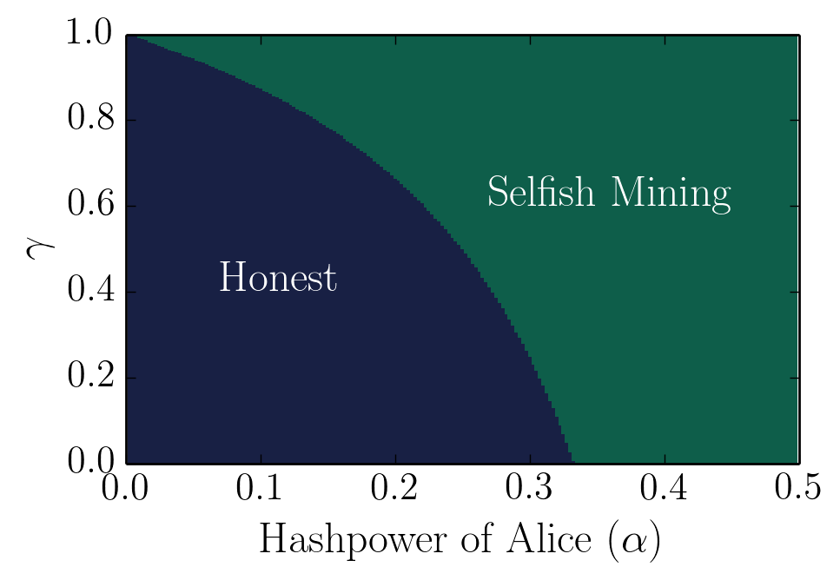
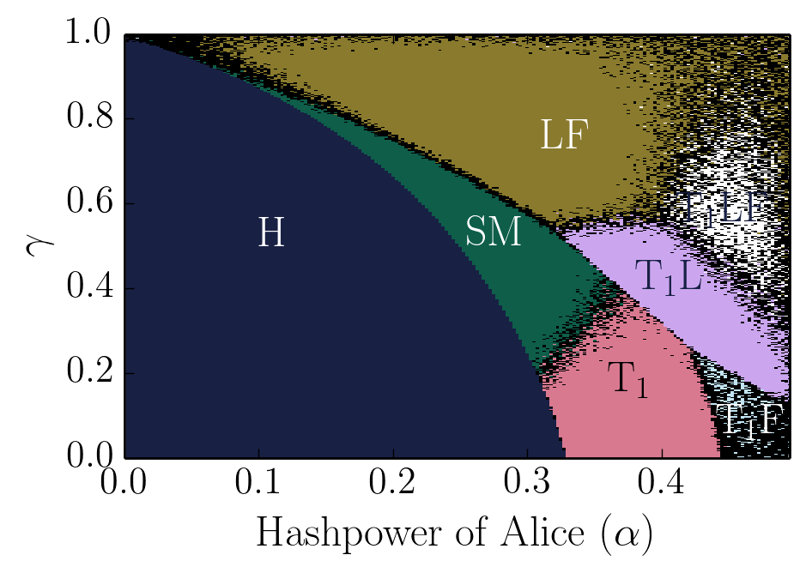
There is no one-size-fits-all dominant strategy.
Results
MonteCarlo simulations
Multiple samples and report mean
γ: Alice’s network influence
(fraction of public mining on Alice’s chain in case of a fork)

Slide 17
For a large parameter space, Stubborn Mining strategies perform better than Selfish Mining.

Slide 18
Trail stubborn strategies perform better than non-trail-stubborn counterparts when α > 0.33

Slide 19
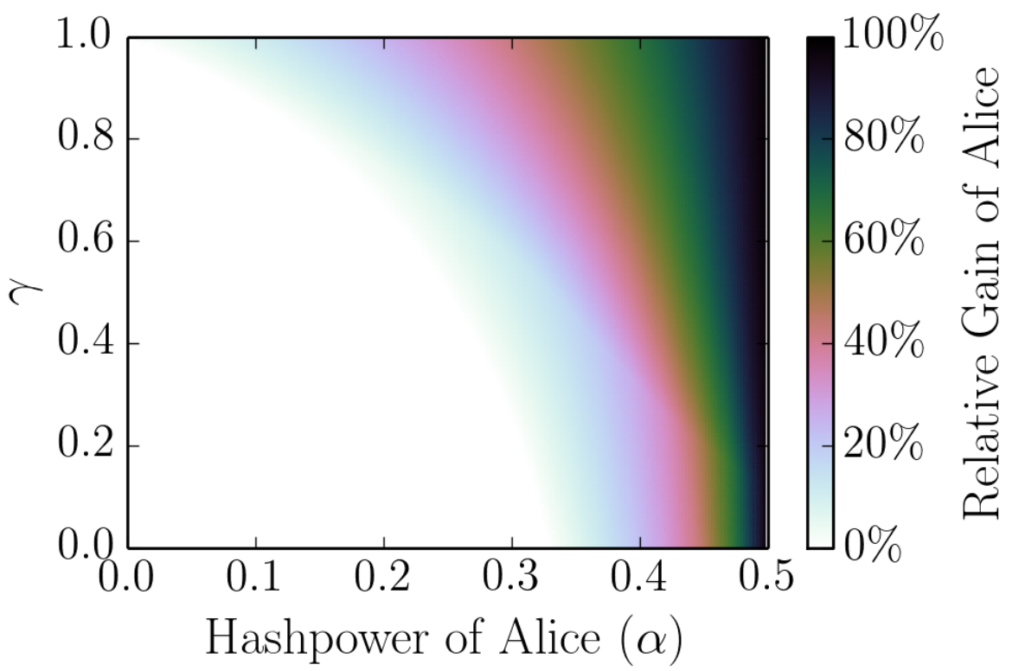
Attacker’s Revenue: Compared to Honest Mining
α = 0.4, γ = 0.9
63% higher revenue
Increase in revenue: ~$375,000 / day

Slide 20
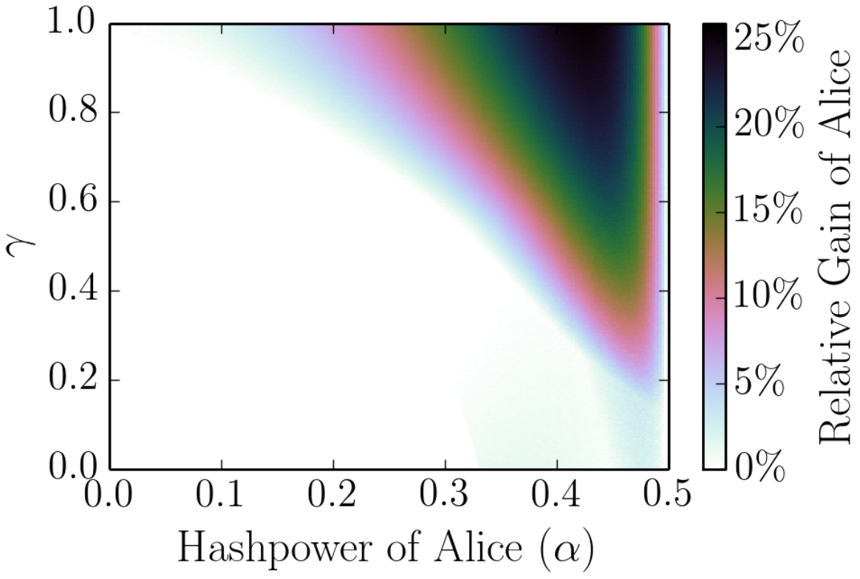
Attacker’s Revenue: Compared to Selfish Mining
α = 0.4, γ = 0.9
23% higher revenue
Increase in revenue: ~$137,000 / day

Slide 21
Eclipse Attacks
(reminder)
World 1
World 2
Bob
Lucy
Dave
Alice
Emily

Slide 22
Eclipse Attacks
(reminder)
Lucy
(λ)
Alice
(α)
Public
(β)
λ < β
World 1
World 2
Bob
Lucy
Dave
Alice
Emily

Slide 23
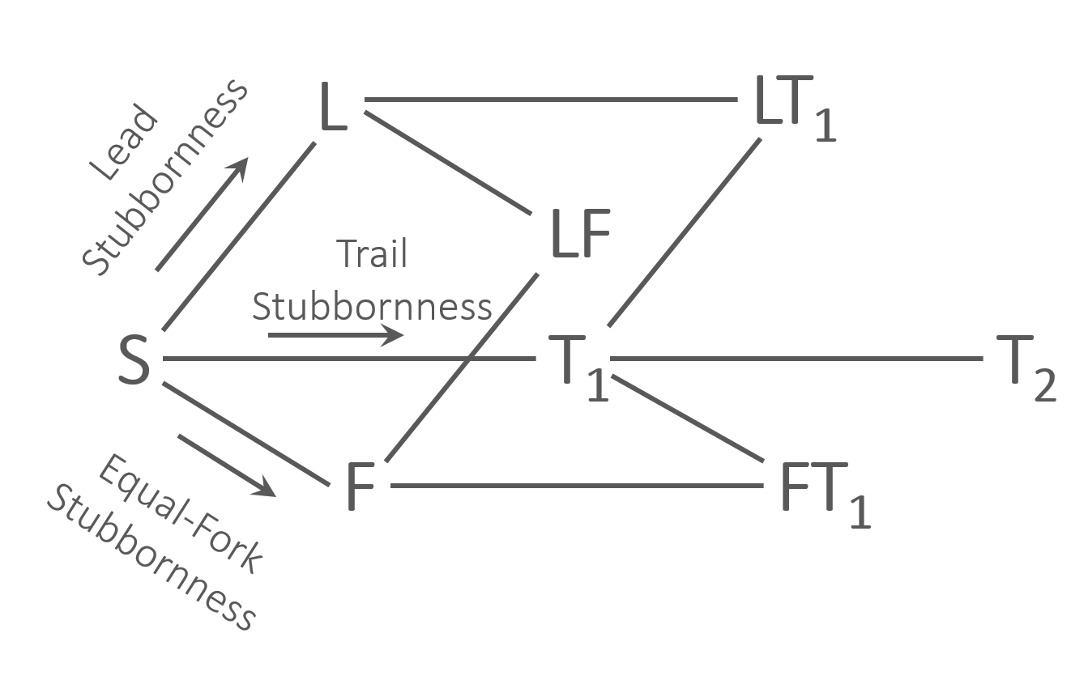
Exploiting Eclipse Attack Victims
No Eclipsing
Lucy
(λ)
Alice
(α)
Public
(β)
Eclipsing degree
Collude with Lucy
1. Forward all messages – no eclipsing
2. Partition all messages – waste Lucy’s computation power
Destroy if no stake
3. Collude with Lucy
4. Destroy if no stake (DNS)
Partition all messages

Slide 24
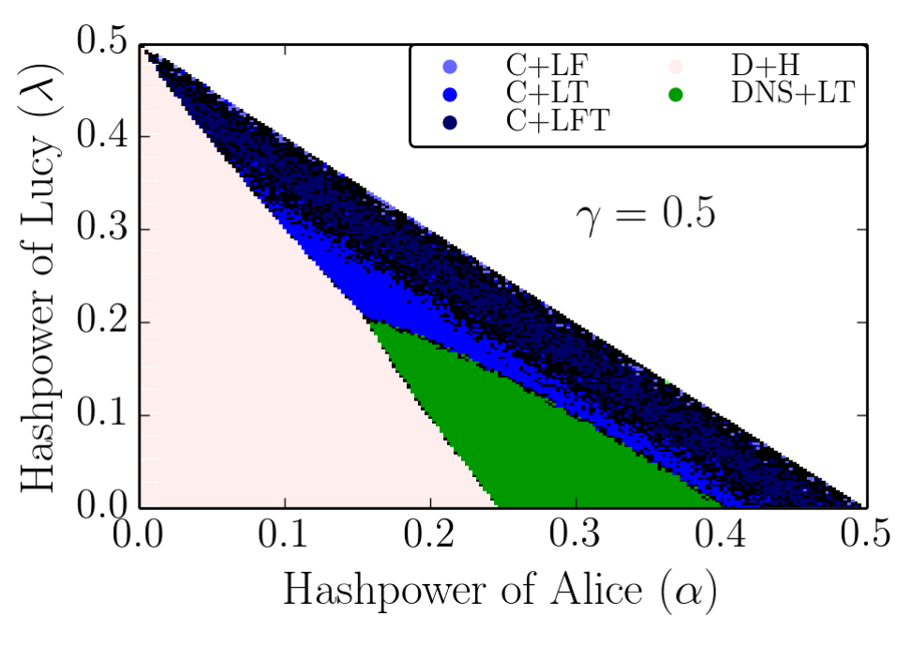
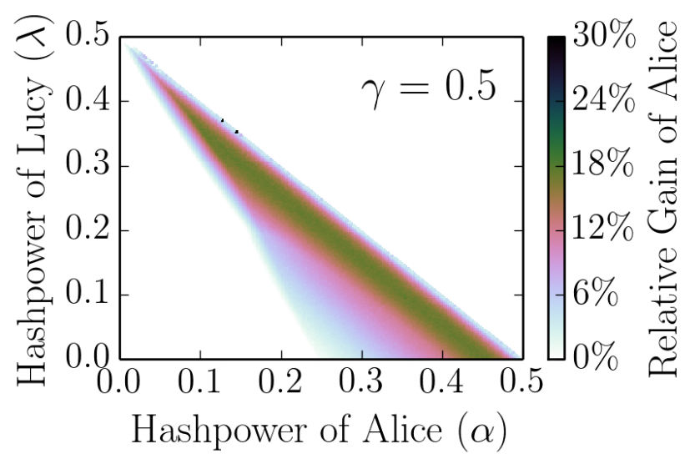
Non-trivial compositions of Stubborn Mining + Eclipsing outperform naïve strategies
Dominant Strategies
Alice’s relative gain wrt naïve
8% gain
Naïve: Honest/Selfish Mining – Stubbornness, Collude/Destroy Lucy - Eclipsing

Slide 25
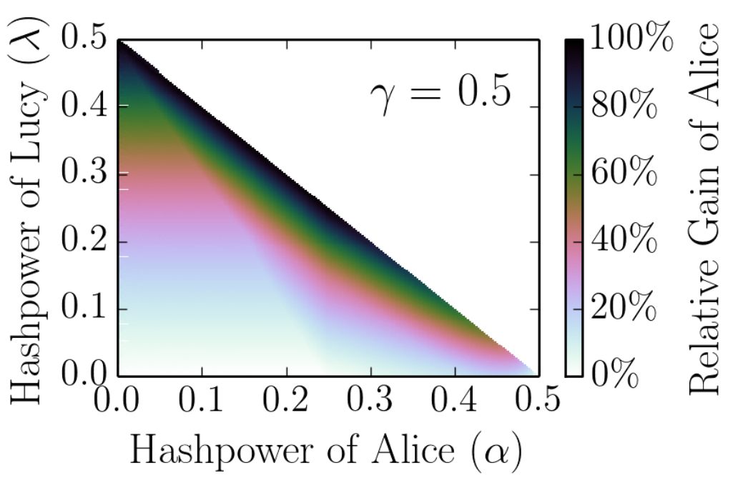
Gain compared to Selfish Mining
Alice’s relative gain wrt Selfish Mining
25% gain

Slide 26
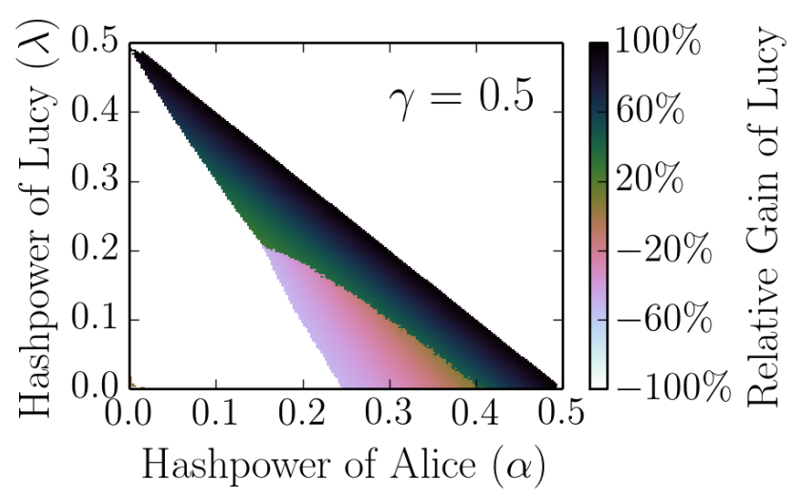
The attack may benefit Lucy
Lucy’s relative gain:

Slide 27
Are these attacks likely to occur?
Selfish Mining not observed until now
~$375,000 / day
Other cryptocurrencies
Detecting and inferring attacks
Discussed in the paper
Countermeasures?
Dispersed mining power

Slide 28
Conclusion
1
Stubborn Mining
2
Compose Stubborn Mining and Eclipse Attacks
Dominant Strategies
kartik@cs.umd.edu
Thank You!

